Slide 1
Github

Slide 2
To Create a New repository - Local
// initialize your repository
git init
// Stash changes
Git add .

Slide 3
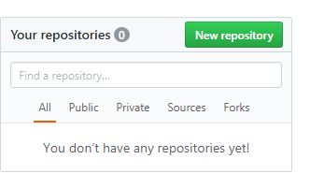
To Create a New repository - Remote
Go to https://www.github.com
Go to New Repository

Slide 4
To Create a New repository - Remote
Go to https://www.github.com
Go to New Repository

Slide 5
Do commit your changes
Do your changes
Stage your changes
Commit your changes

Slide 6
Check logs
All logs
git log
2. Check log lines
git log –oneline -10

Slide 7
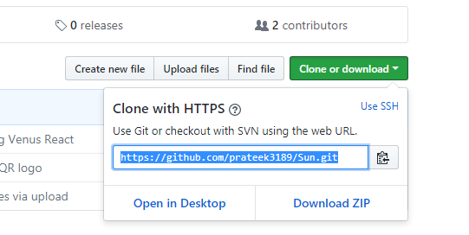
Clone repository
Get the repository path

Slide 8
Clone repository
Go to console
git clone https://github.com/prateek3189/Sun.git

Slide 9
Befor Commit: Set your user.name and email
git config –global user.name
git config –global user.email

Slide 10
Commit your change
git commit –m “Your Comments”

Slide 11
Push your changes
git push –f origin <branch_name>

Slide 12
Branching
// Create branch locally
git checkout –b <branch_name>
// Push branch on remote
git push –u origin <branch_name>

Slide 13
Stashing
// Save changes
git stash save “Some comment”
// Check for all stash
git stash list
// Apply stash changes
git stash apply stash@{0}
// Pop (Apply and Drop) stash changes
git stash pop stash@{0}
// Drop stash changes
git stash drop stash@{0}

Slide 14
Rebasing
git rebase –I <parent_branch>
Replace keyword pick by squash
And :wq
Keep your comment only
git push –f origin <branch_name>

